Slide 1
Auto Pilot
Task 5

Slide 2
Team 4
B.N. | Sec | Name
37 | 2 | Mohammed Ahmed Hassan Ahmed
1 | 1 | Ibrahim Thabet Allam
39 | 2 | Mohammed Hatem Mohammed Saeed
41 | 2 | Mohamed Hassan Gad Ali
43 | 2 | Mohammed Abd El MawgoudGhoneam

Slide 3
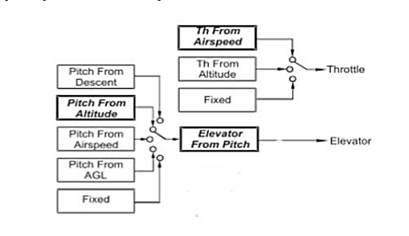
Introduction:
In order to Design a controller first of all we should get the transfer functions of all full longitudinal dynamics model.
Our methodology is to using inner loops architecture.
Then using SISO tool to design the controller.
Finally we use SIMULINK to check the performance of our design.

Slide 4
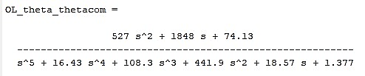
Design Pitch Controller With Pitch Rate Feedback
The open loop transfer function is:

Slide 5
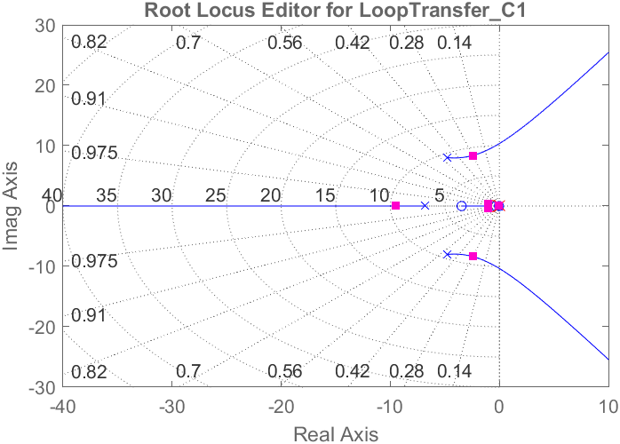
SISO Tool Design
Root locus

Slide 6
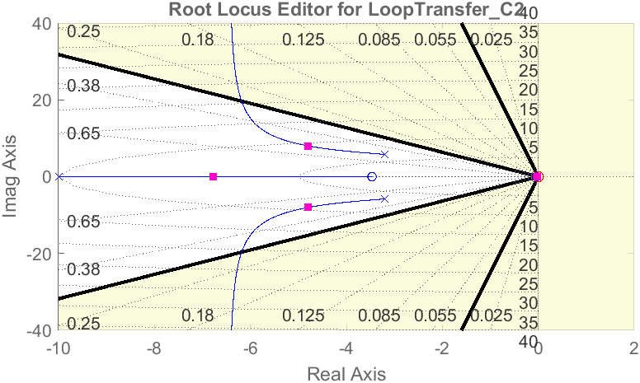
SISO Tool Design
Root locus

Slide 7
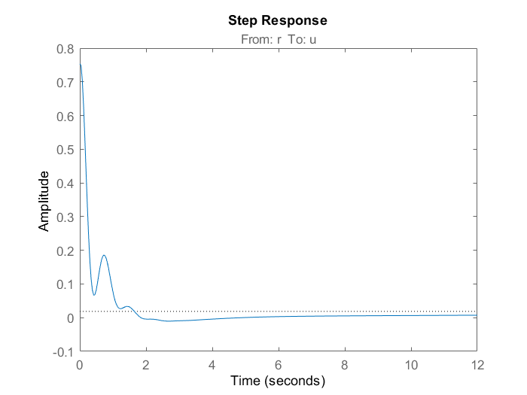
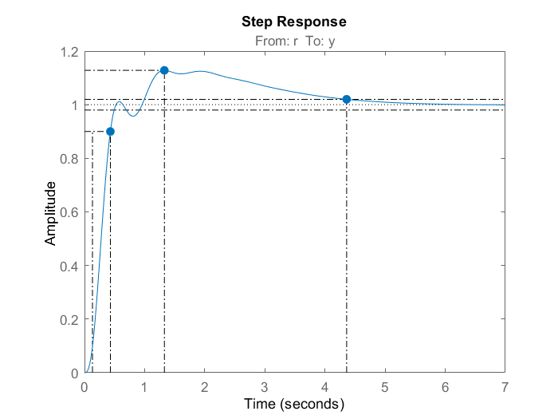
Step response
Control action
System Response

Slide 8
Simulink test

Slide 9
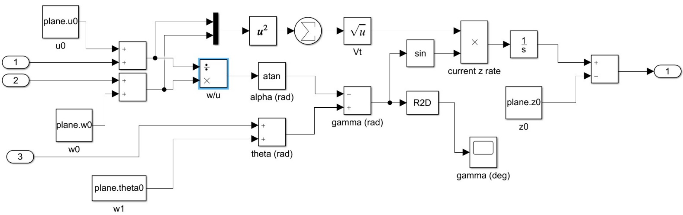
Simulink test

Slide 10

Necessity of velocity control

Slide 11
Necessity of velocity control
when we input positive pitch angle, the action depends on the thrust if the thrust is big enough to climb upward the airplane will climb upward if the thrust is not enough the airplane would dive downward but logically, when the pilot input a positive pitch the airplane should climb upward

Slide 12
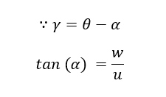
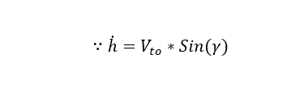
Necessity of velocity control

Slide 13
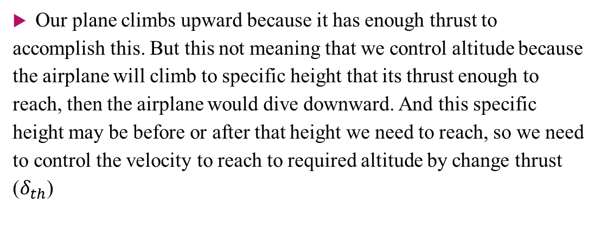
Necessity of velocity control
Our plane climbs upward because it has enough thrust to accomplish this. But this not meaning that we control altitude because the airplane will climb to specific height that its thrust enough to reach, then the airplane would dive downward. And this specific height may be before or after that height we need to reach, so we need to control the velocity to reach to required altitude by change thrust ($δ_{th}$)

Slide 14
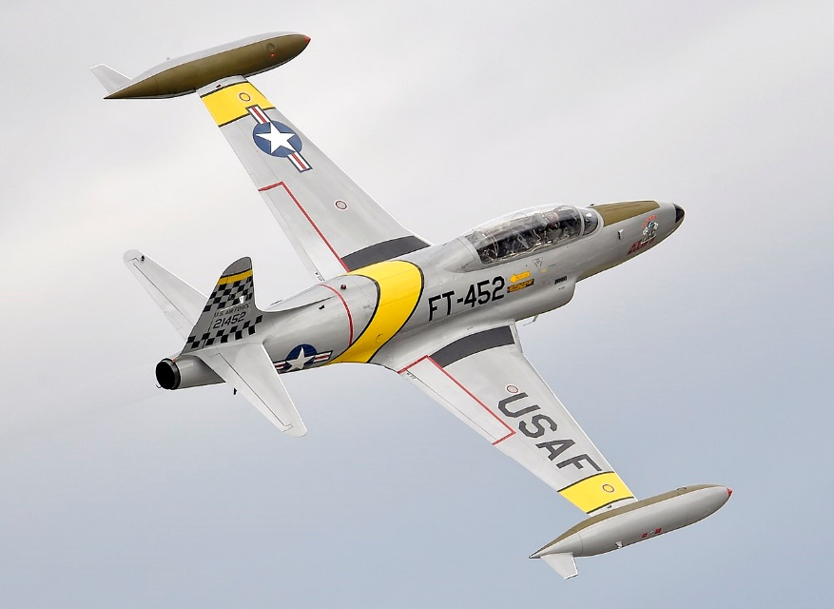
NT-33A engine
Our aircraft ‘NT-33A’ was a training aircraft that was developed from the Lockheed martin.
The Powerplant installed is 1 × Allison J33-A-35 centrifugal flow turbojet engine, with 5,400 lbf (24 kN) thrust for take-off with water injection
4,600 lbf (20,461.82 N) maximum continuous thrust.

Slide 15
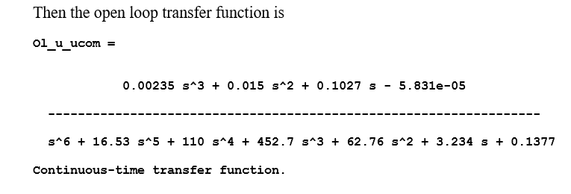
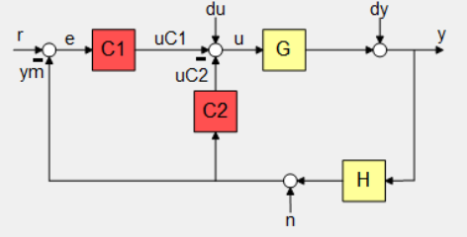
Velocity Controller

Slide 16


Velocity Controller

Slide 17
Step response & Control action
Step response
Control action

Slide 18
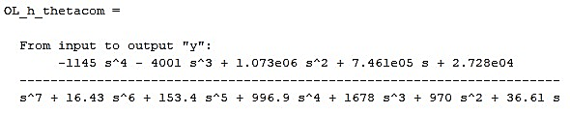
Altitude controller

Slide 19


Altitude Controller

Slide 20
Step response & Control action
Step response
Control action

Slide 21

simulation
Results

Slide 22
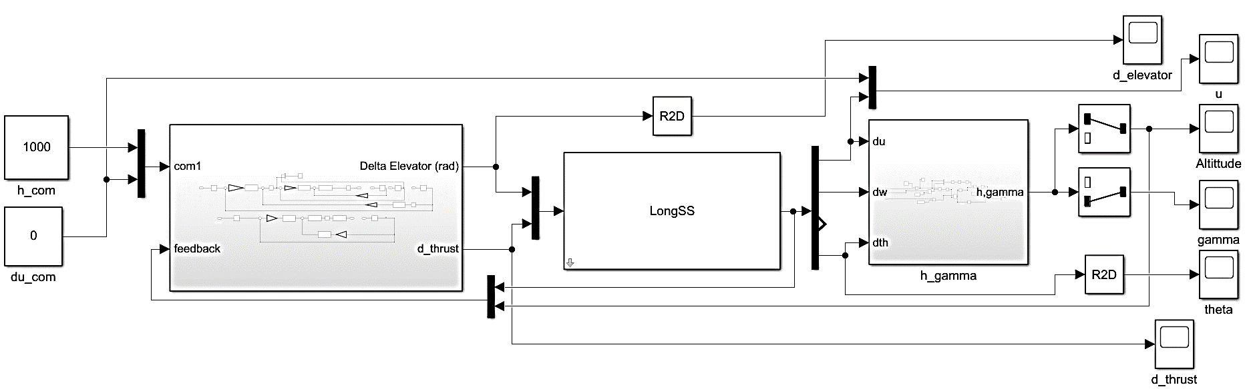
Simulation Blocks

Slide 23
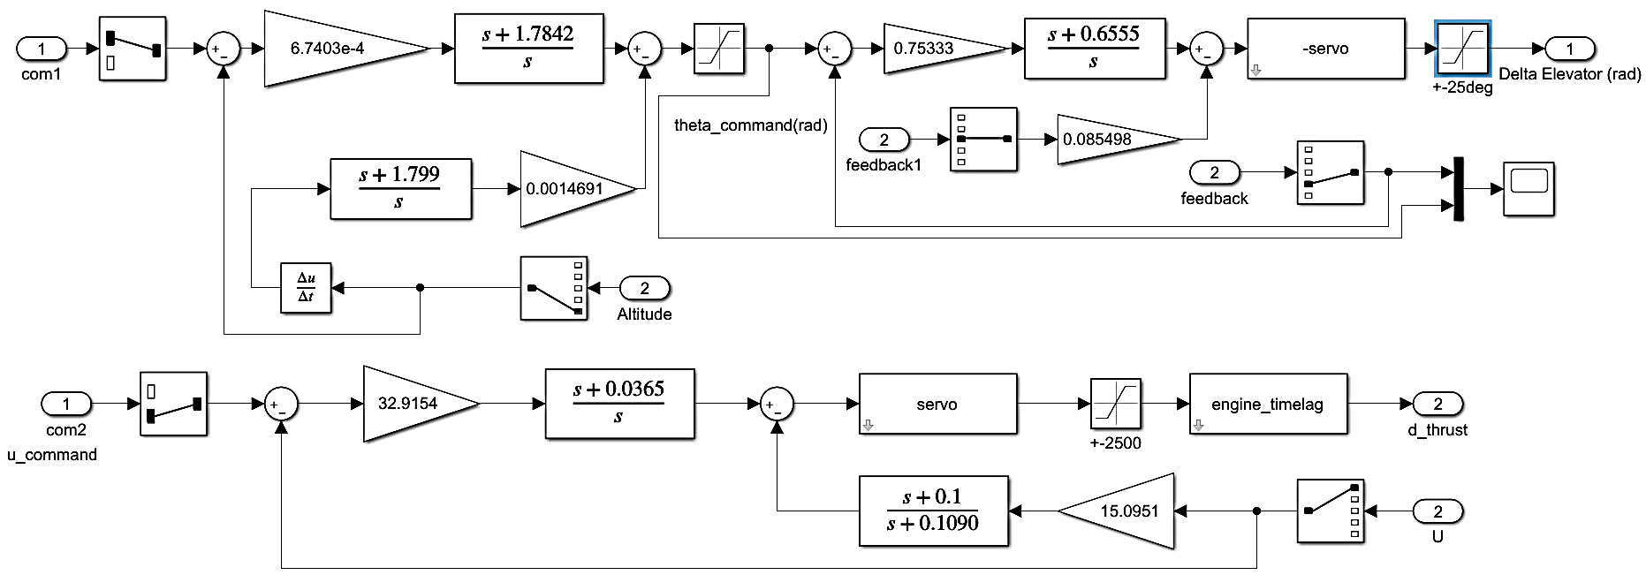
Simulation Blocks

Slide 24
Simulink Results of 1000ft Command

Slide 25
Simulink Results of 1000ft Command

Slide 26
Simulink Results of 1000ft Command

Slide 27
Thank You

